Slide 1
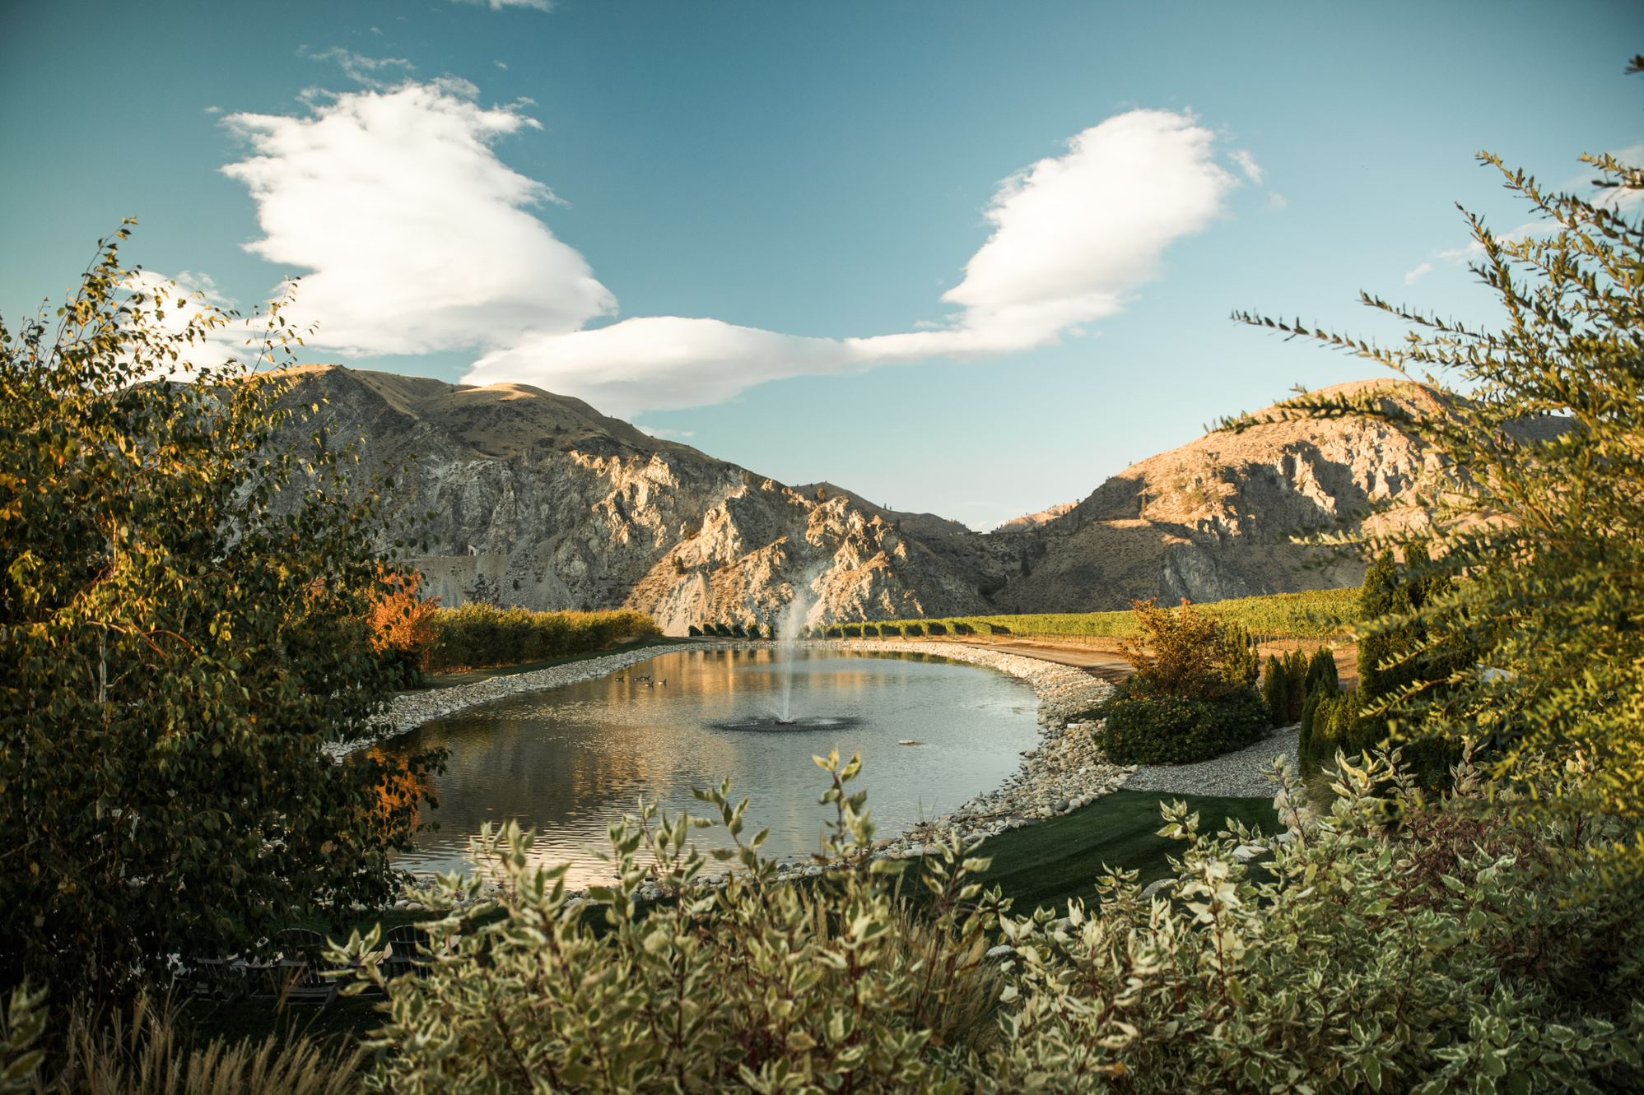
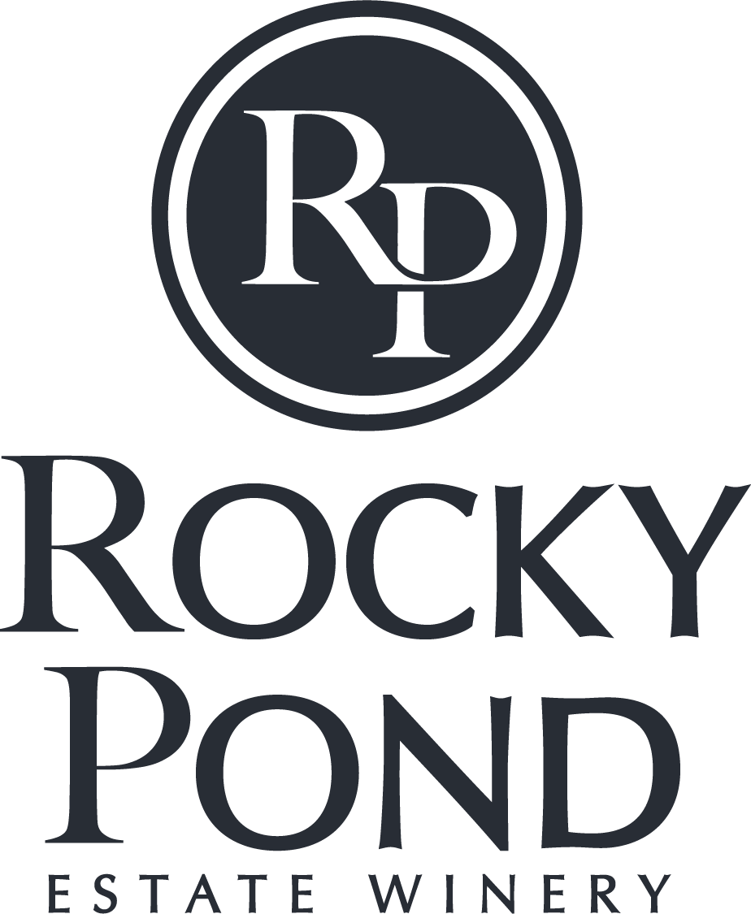

Slide 2
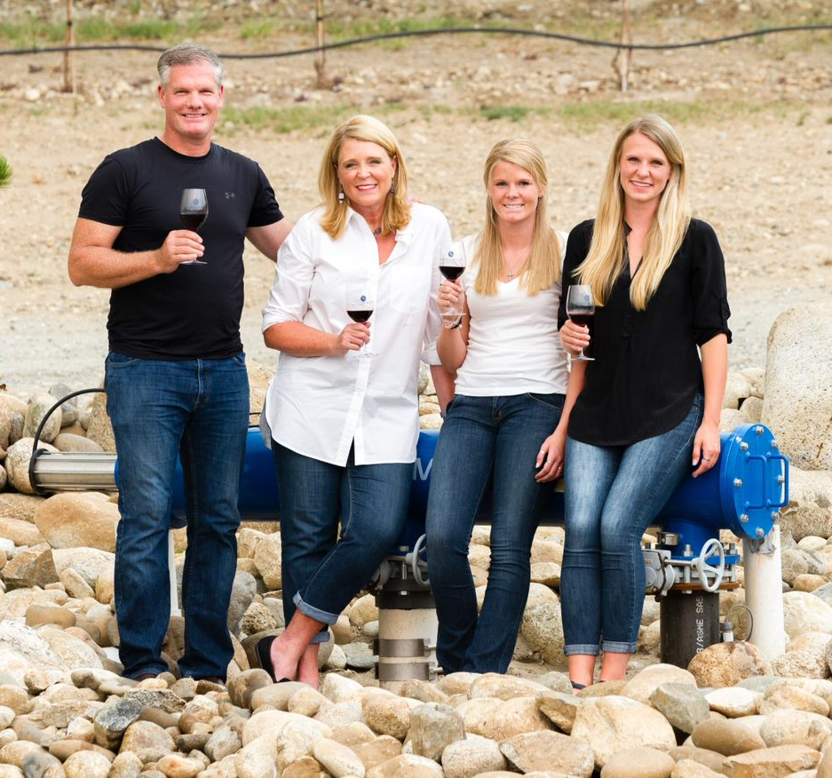
OUR STORY
David Dufenhorst spent decades as a real estate developer, traveling the world with his wife Michelle and their two daughters – Danielle and Cyndee. Captured by the love of land and responsible stewardship, David and Michelle planted their family’s roots in the small town of Orondo, Washington.
Rocky Pond Winery was officially established in 2013, and Proprietary Rock was launched by the Dufenhorst family in 2021.

Slide 3
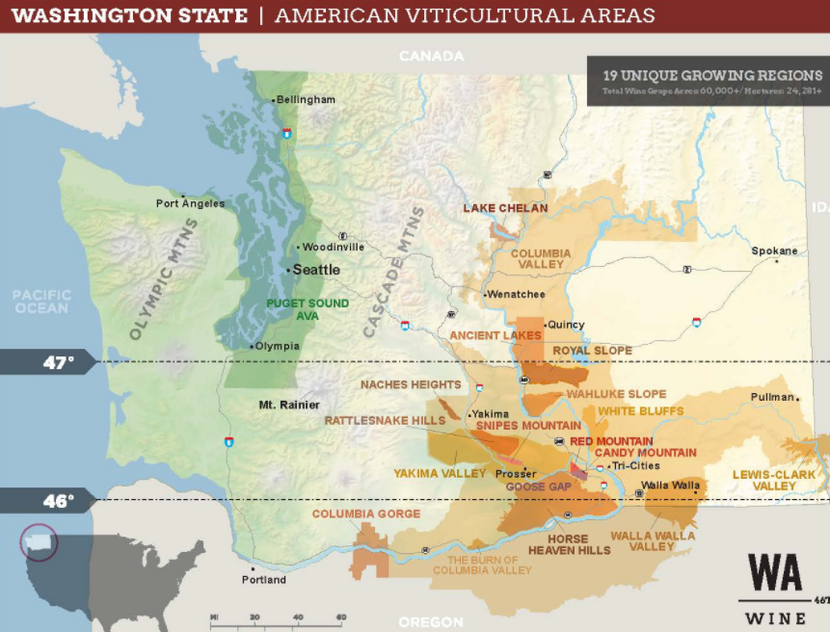
THE “WHERE” OF
ROCKY POND ESTATE WINERY
What originally began as a small 30-acre orchard, has turned into 300 acres of pristine estate land located alongside the mighty Columbia River.
Today, there are a total of 120.52 planted acres, producing 24 different varieties from three vineyard sites.
  Clos CheValle – Lake Chelan AVA
  Double D Vineyard - Columbia Valley AVA
  Rocky Reach Estates - Columbia Valley AVA
Rocky Pond

Slide 4
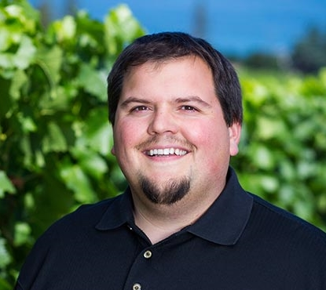
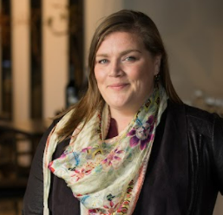
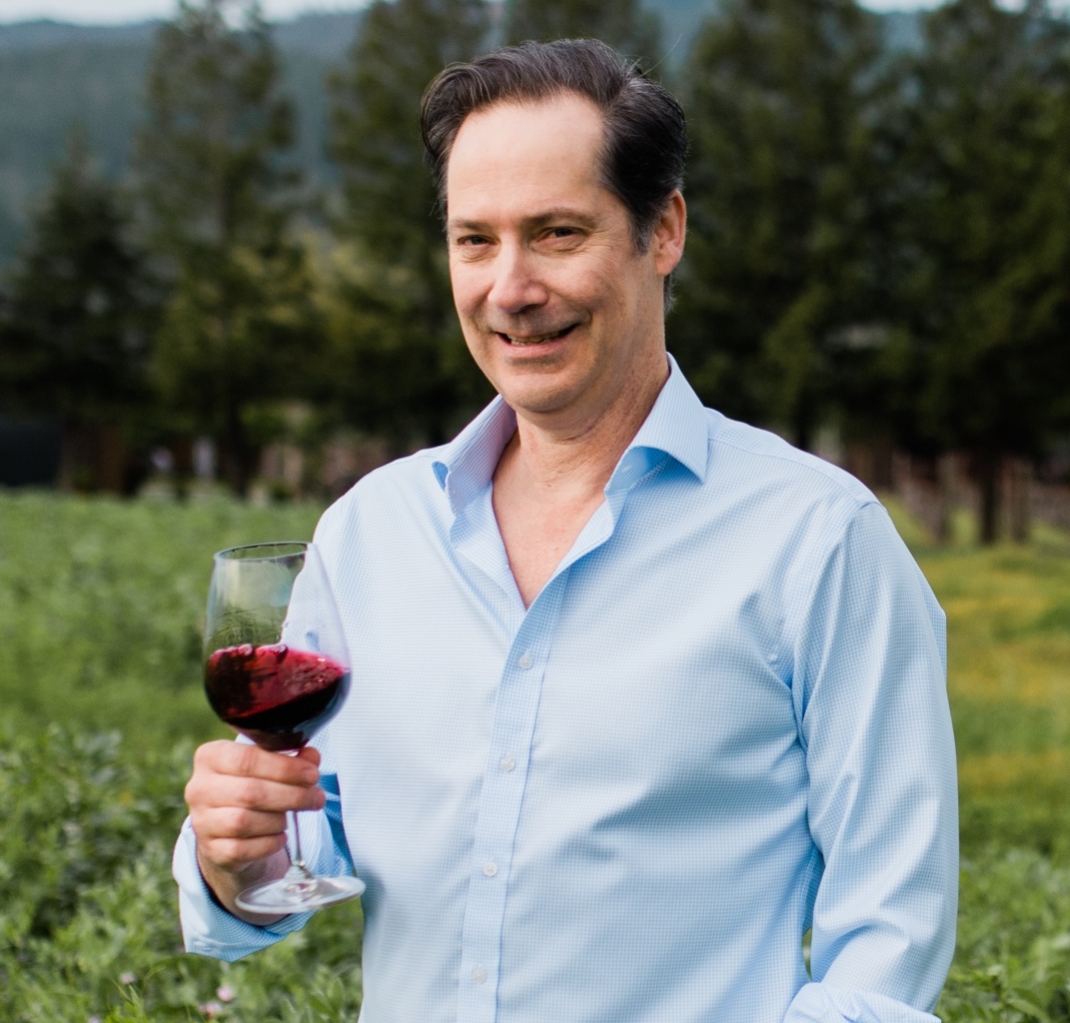
THE PEOPLE BEHIND
THE WINE
Shane Collins, Director of Viticulture: Shane is a fourth-generation orchardist and native of the Lake Chelan Valley. After graduating from WSU, his interests in farming and agriculture encouraged him to pursue the field of viticulture and enology. Shane served 10 years as a board member of the Lake Chelan Wine Alliance and is currently the Chair of the Washington Winegrowers Association.
Elizabeth Keyser, Winemaker: Elizabeth is a recent transplant from the Napa Valley where she held the title of Assistant Winemaker at the highly acclaimed HALL Family Wines. Prior to her time at Hall, Elizabeth held key winemaking roles at Napa’s Cliff Lede, A to Z Wineworks in Oregon, and Hardy’s Tintara in Australia.
Steve Leveque, Consulting Winemaker: Steve began consulting for Rocky Pond in 2020. Leveque’s winemaking resume is impressive, resplendent with Napa icons such as Chalk Hill, Opus One, Mondavi, and HALL. Steve is not only a winemaker, but also a viticulturist — he implements careful environmental practices with all his wine-growing efforts.

Slide 5
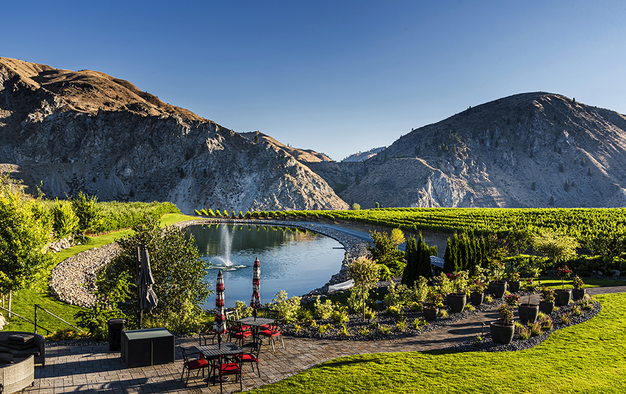


COMMITMENT TO
SUSTAINABILITY
All fruit is sourced from three estate vineyards, each Salmon-Safe and LIVE Certified.
All products are designed with responsible packaging (100% natural cork, paper labels and lightweight bottles).
The winery reclaims water used in the winemaking process to irrigate Rocky Reach Vineyard.
Shown in the photo is a 1.1 million gallon pond that irrigates Rocky Pond’s flagship vineyard, Double D Vineyard.

Slide 6

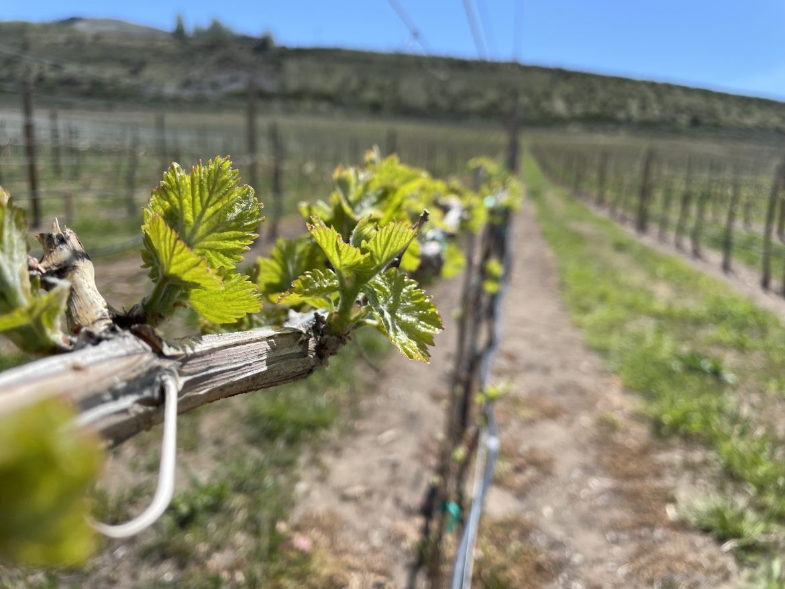
A NEW CHAPTER FOR WA
Sustainability includes a broad set of science-based practices developed for local conditions and vineyard and winery scale. Objectives include natural resources, watershed protection, soil health, low input farming, employee and community stewardship and climate resiliency.
Sustainable WA was built by and for the industry, specifically for Washington vineyards.

Slide 7
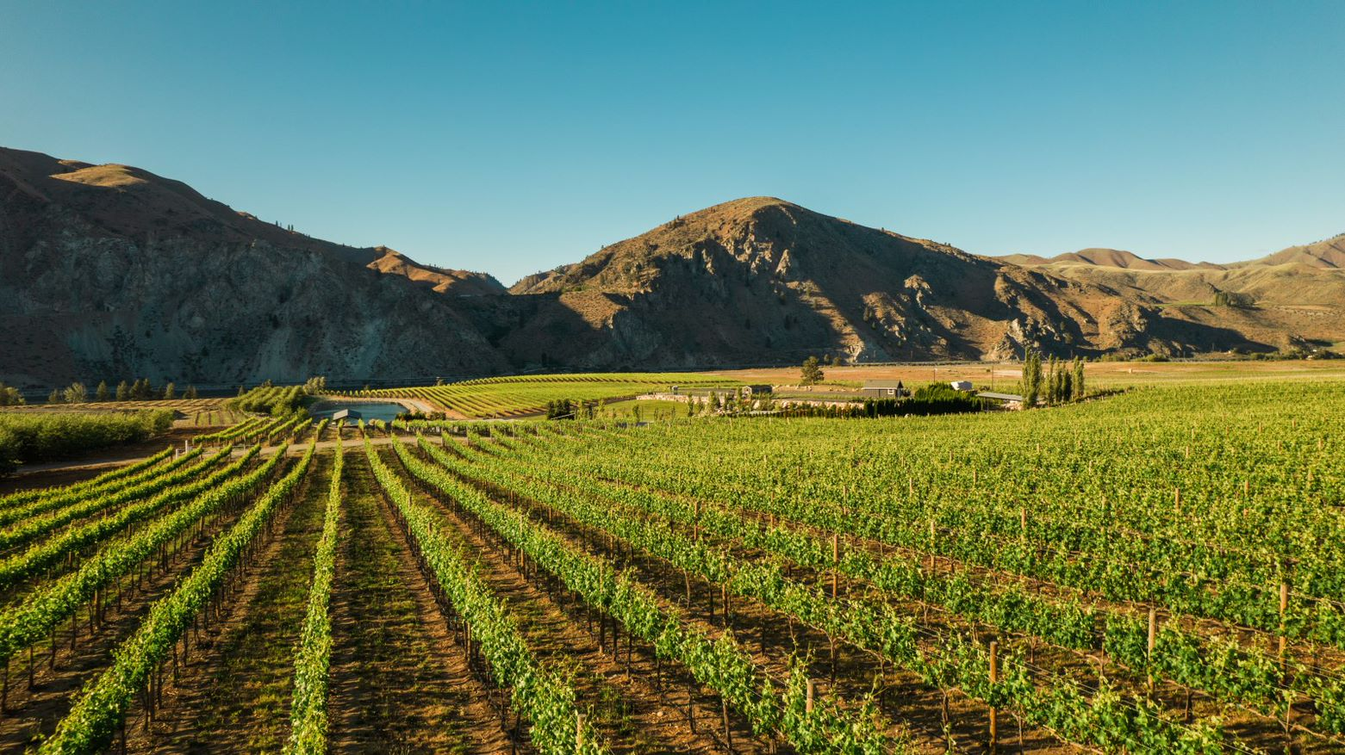
A NEW CHAPTER FOR ROCKY POND
Double D Vineyard is one of five vineyards in Washington that is certified Sustainable WA and will appear on 2022 vintage labels.
Shane Collins, our Director of Viticulture and Chairman of the WA Winegrowers Association, helped design and launch this third-party certified program.
Rocky Pond's transition to the Sustainable WA program was a natural one from their existing LIVE certification.

Slide 8
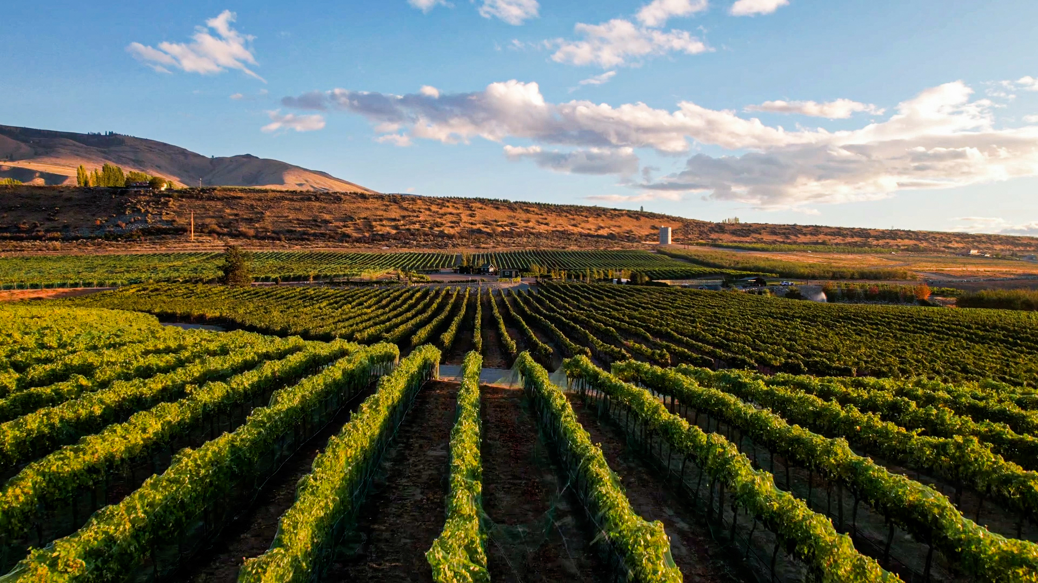
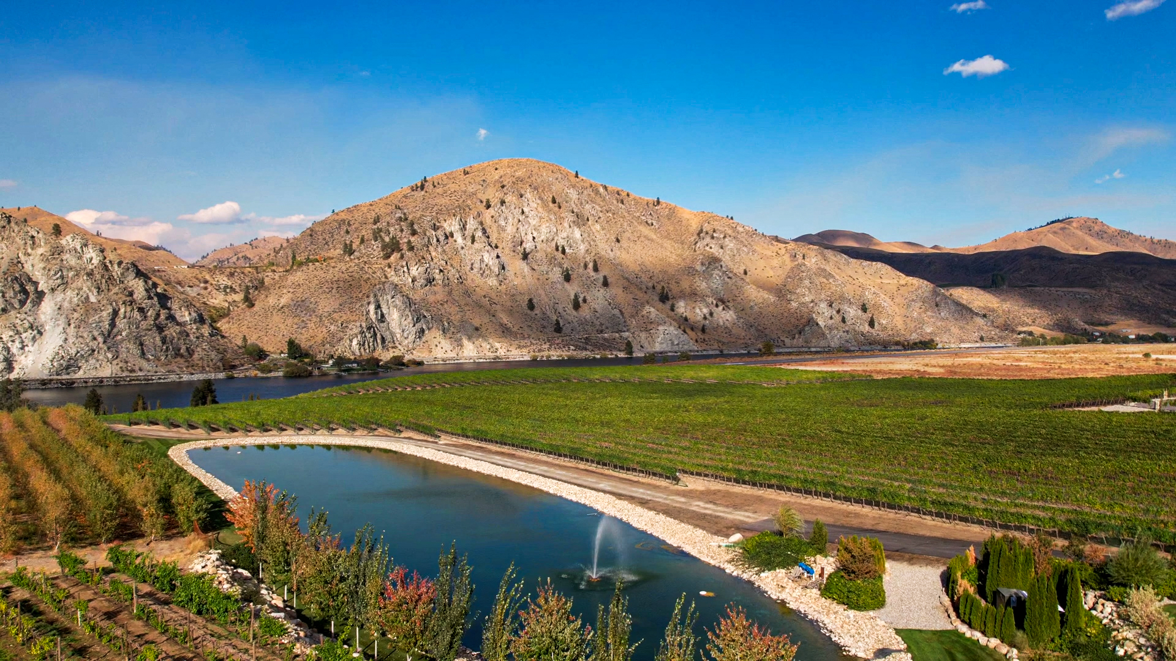
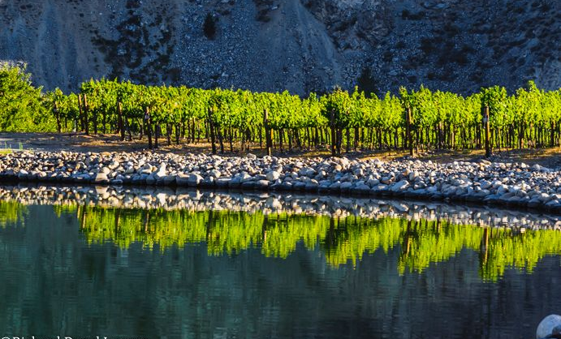
ROCKY REACH AVA
GEOGRAPHY
On July 5th, 2022, the Rocky Reach AVA was declared as the 20th AVA of Washington State.
Rocky Reach AVA takes its name from the Rocky Reach Dam and the Rocky Reach Reservoir (also known as Lake Entiat). Steamboat captains first applied the name “Rocky Reach” to the region in the late 1800’s, to describe the rapids within a stretch, or “reach”, of the Columbia River.
Rocky Reach AVA encompasses 32,333 acres (50 square miles) and is located along both sides of the Columbia River starting at the Rocky Reach Reservoir and ending upriver near the Lone Pine Café.
Approximately 7,900 acres, constituting 24 percent of the area is occupied by the Columbia River and Rocky Reach Reservoir.

Slide 9

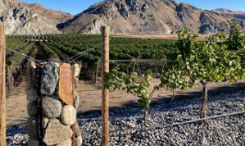
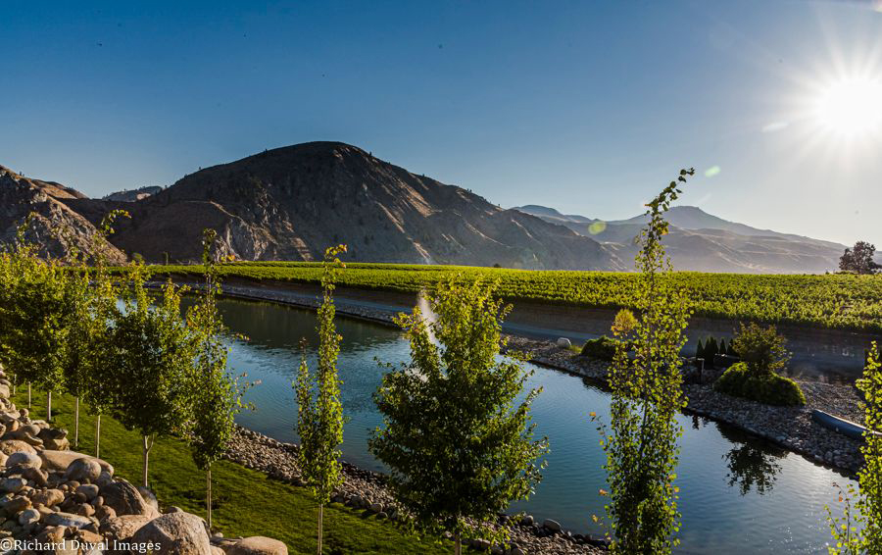
ROCKY REACH AVA
GEOLOGY
Rocky Reach AVA consists of crystalline basement rocks which are silica rich due to the mica and quartz minerals. This is in contrast to the existing Columbia Valley AVA which is 95% basalt. ​
The soils are formed from wind-deposited sand and silt overlying cobblestone gravel, and sand deposited by ice-aged floods. The stony surfaces warm quickly, and the hot stones radiate and retain daytime heat to the vines and promote faster and more complete ripening.
​The gravels were deposited approximately 18,800 years ago by gigantic floods associated with the failure of a glacial ice dam and the subsequent draining of Glacial Lake Missoula in Western Montana and Okanagan glacier.
Summary: The climate within Rocky Reach is ideal for grape growing as the elevations are low allowing for a warmer and longer growing season more than 150 days. Higher quality fruit creates the opportunity for even better wines.

Slide 10
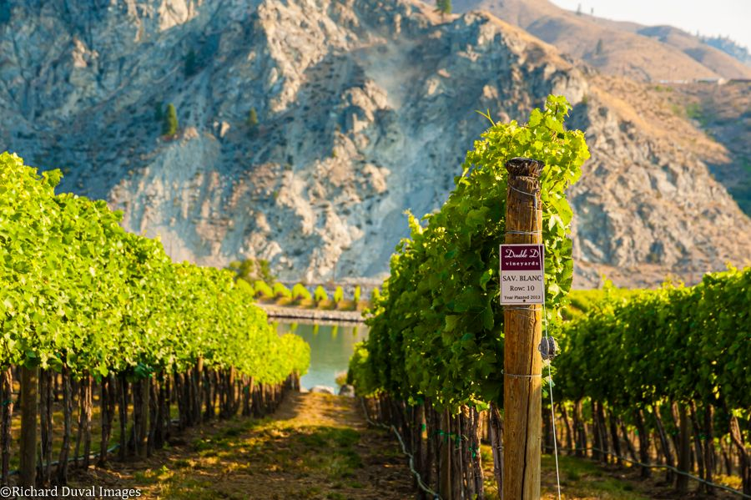
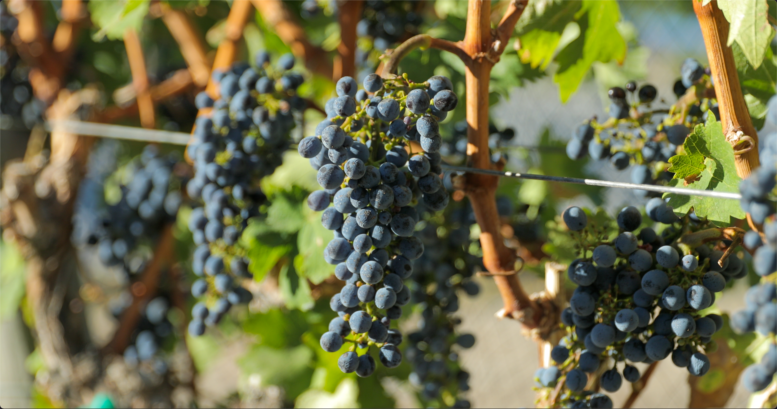
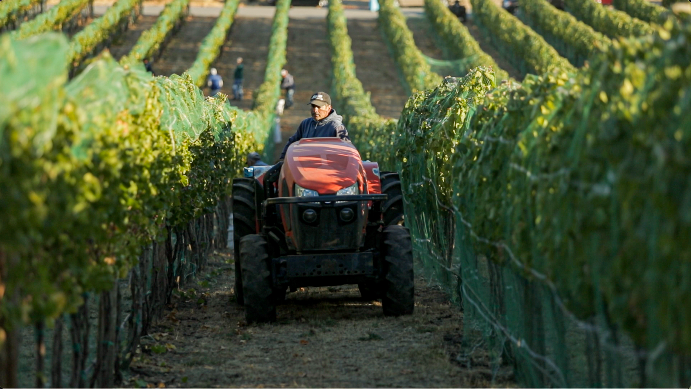
OUR FLAGSHIP VINEYARD
Double D Vineyard
The flagship Double D Vineyard (named after the original “DD”— David Dufenhorst) has a north-facing slope with 55 acres of Bordeaux and Rhône varieties. This is one of the hottest sites in Washington State, with similar heat units to Red Mountain.
Unique Geology:
Double D is a low-density vineyard situated riverside between Wenatchee and Chelan.
The bedrock is migmatite which is composed of metamorphosized tonalite that became gneiss in the Missoula Flood outwash process.
The elevation ranges from 740 to 900 feet.
DD’s soil type is defined as pogue cobble fine sandy loam. As you walk the vineyard, you can see a myriad of cobblestones protruding from soils.
There is nowhere else in the world like it!

Slide 11
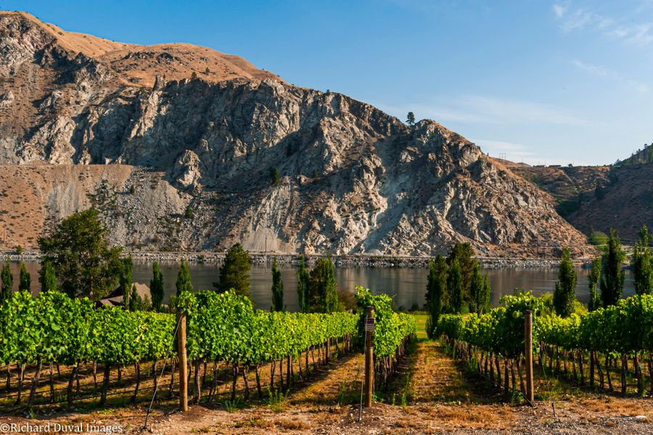
“THE MOUNTAIN”
“Just as vines dig roots deep into the soil, they’ve sunk those roots deep into us, too. This is our home”
“Just as vines dig roots deep into the soil, they’ve sunk those roots deep into us, too. This is our home”

Slide 12
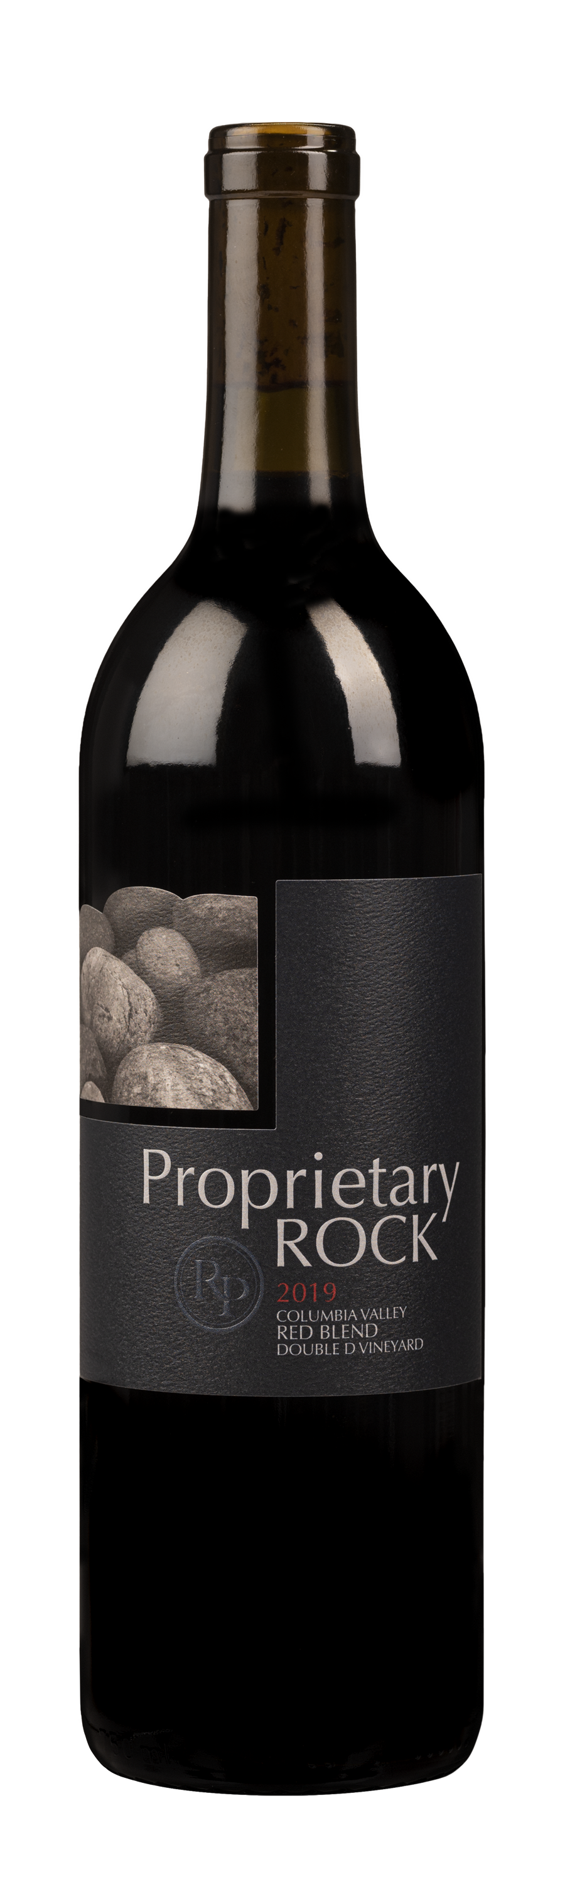

“The wine has the structure one might expect from a well-made Bordeaux style wine, with ample notes of dark cherry, black currant, and dried plum, along with some savory herbal notes. Soft but noticeable tannins leave a long finish. Enjoy with a hearty meal or decant before enjoying is suggested if you don't lay this wine down. Tastes more like a young $35 wine.”
-Wine Panel
Certified L.I.V.E.
Salmon Safe
Single Vineyard
Family owned and operated
3 Wines: Unique Bordeaux blend, Cabernet Sauvignon, and Merlot
Good Price/Quality ratio
Perfect for Wine Clubs, BTG, Etc.

Slide 13
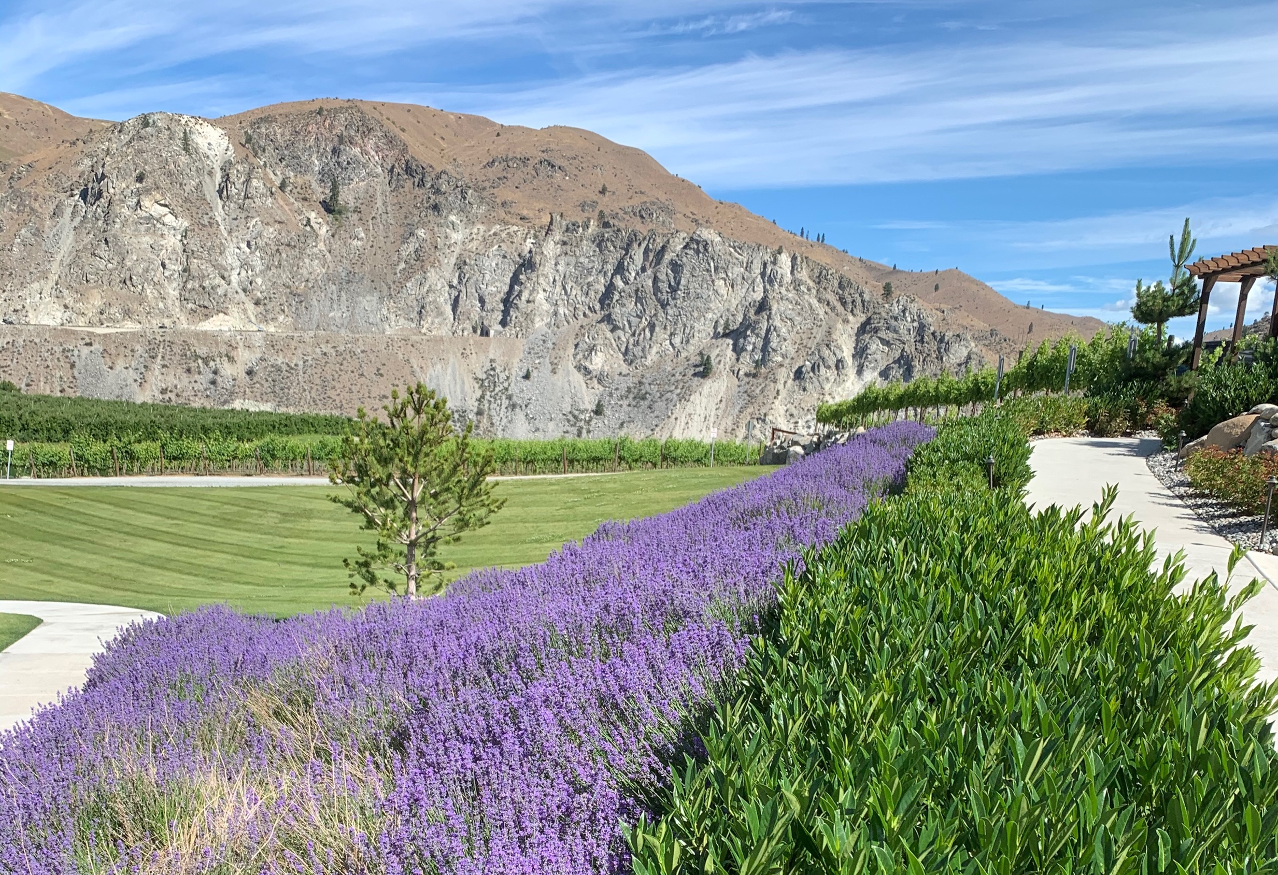
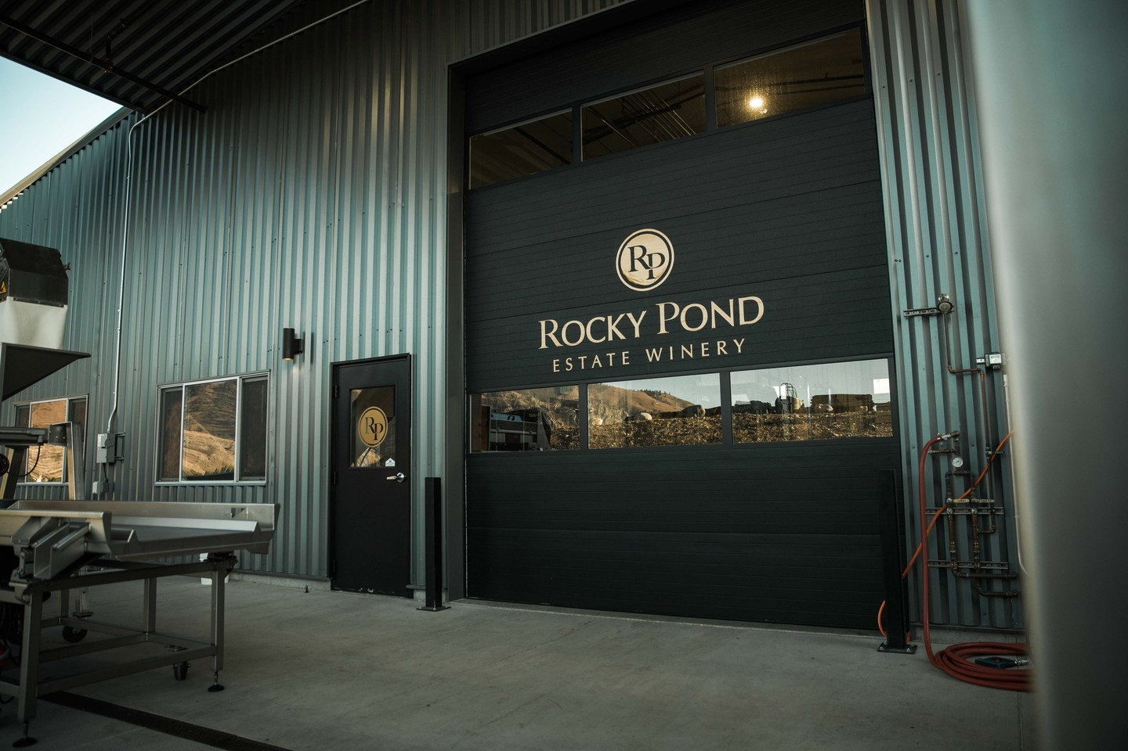
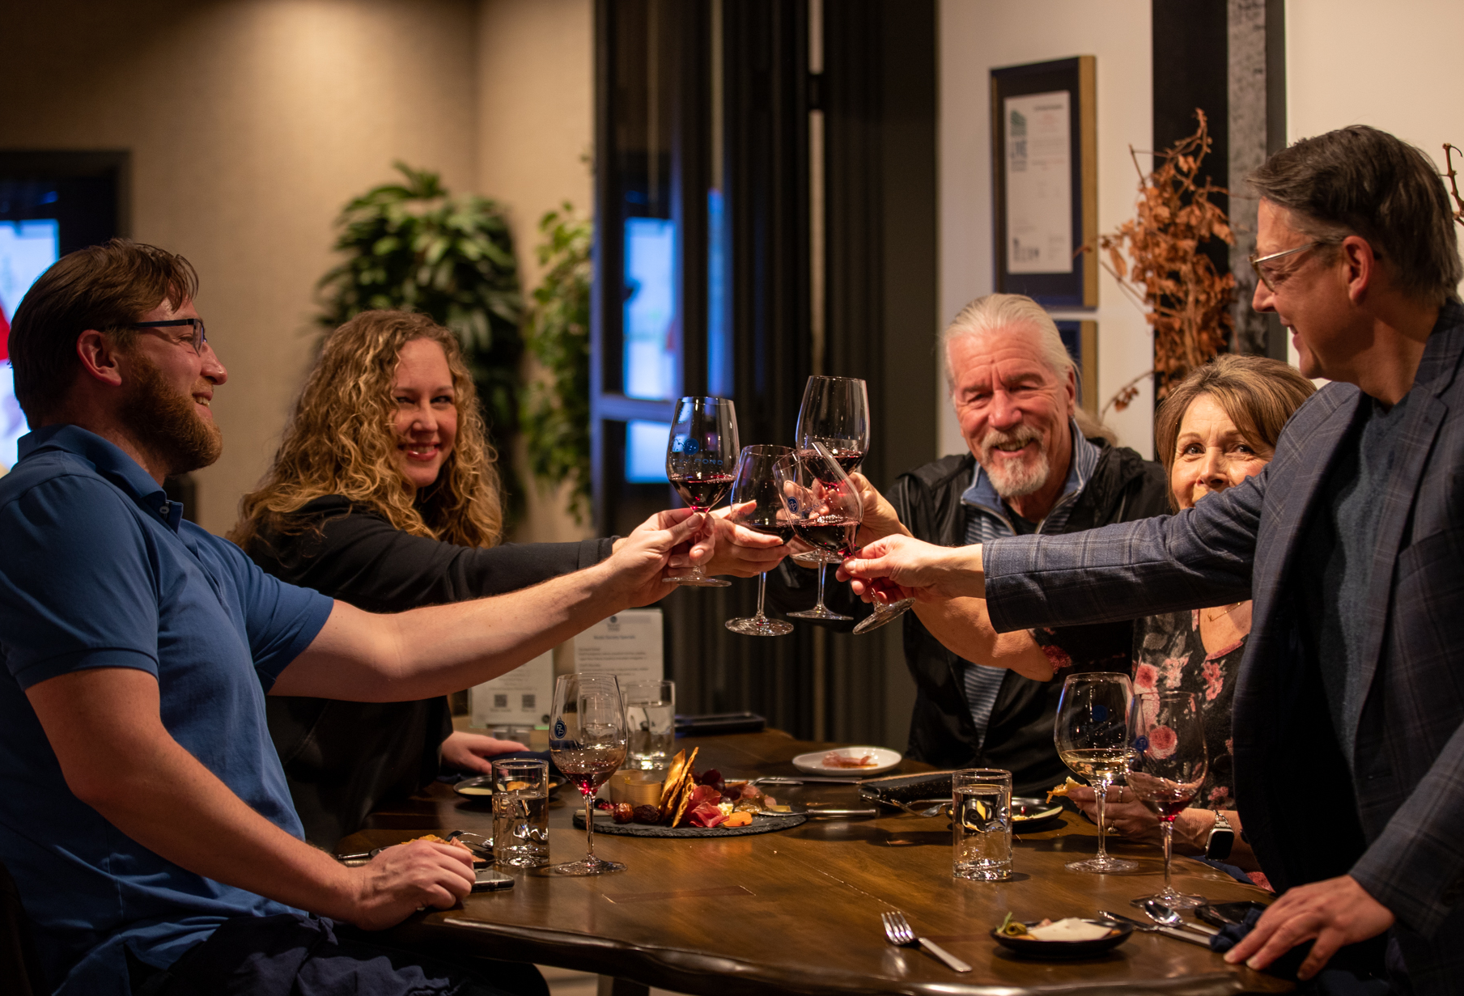
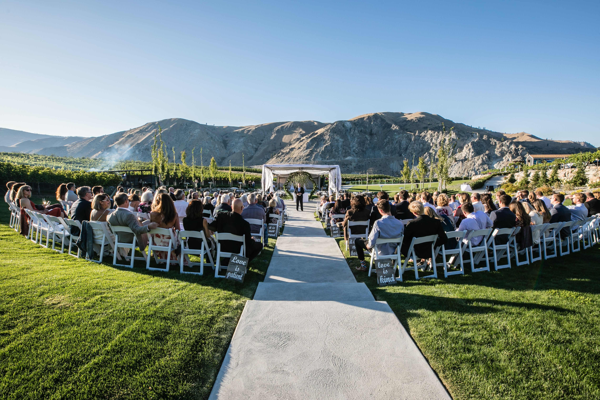
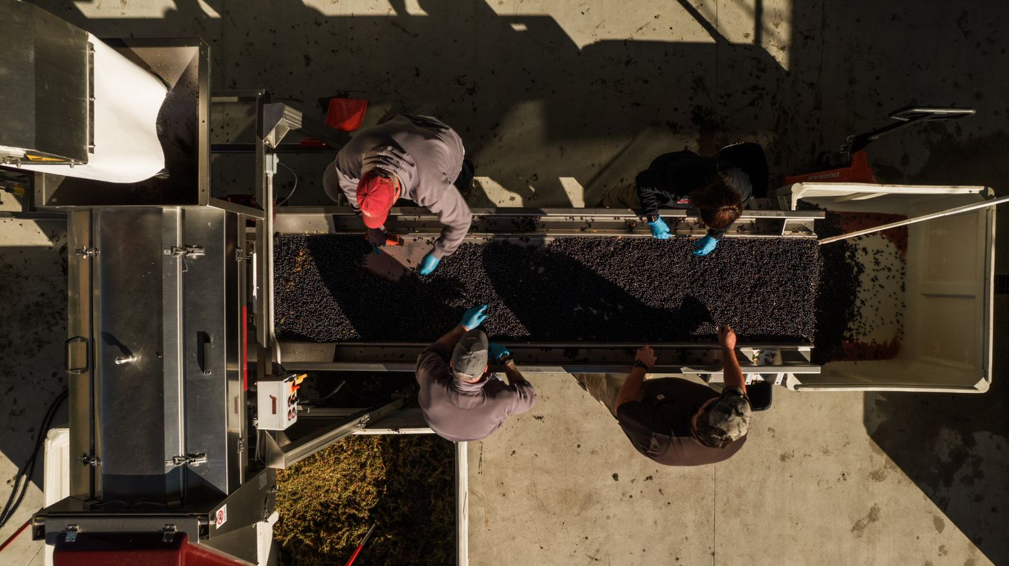
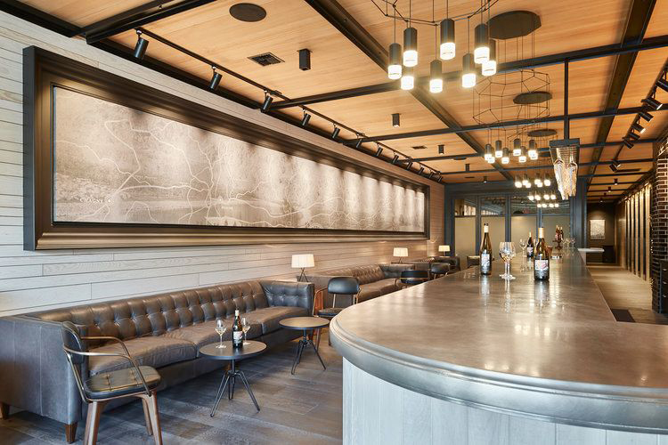
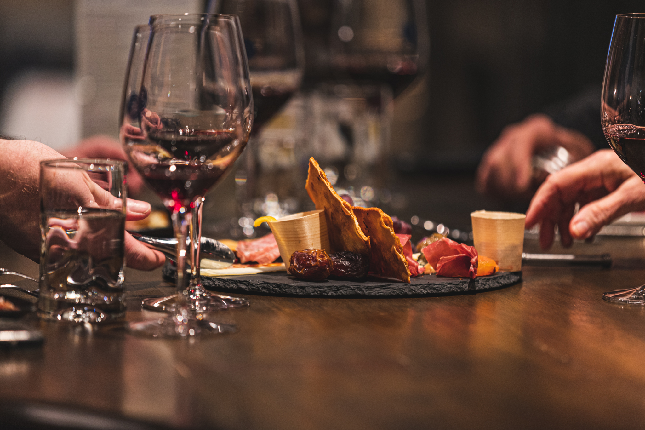
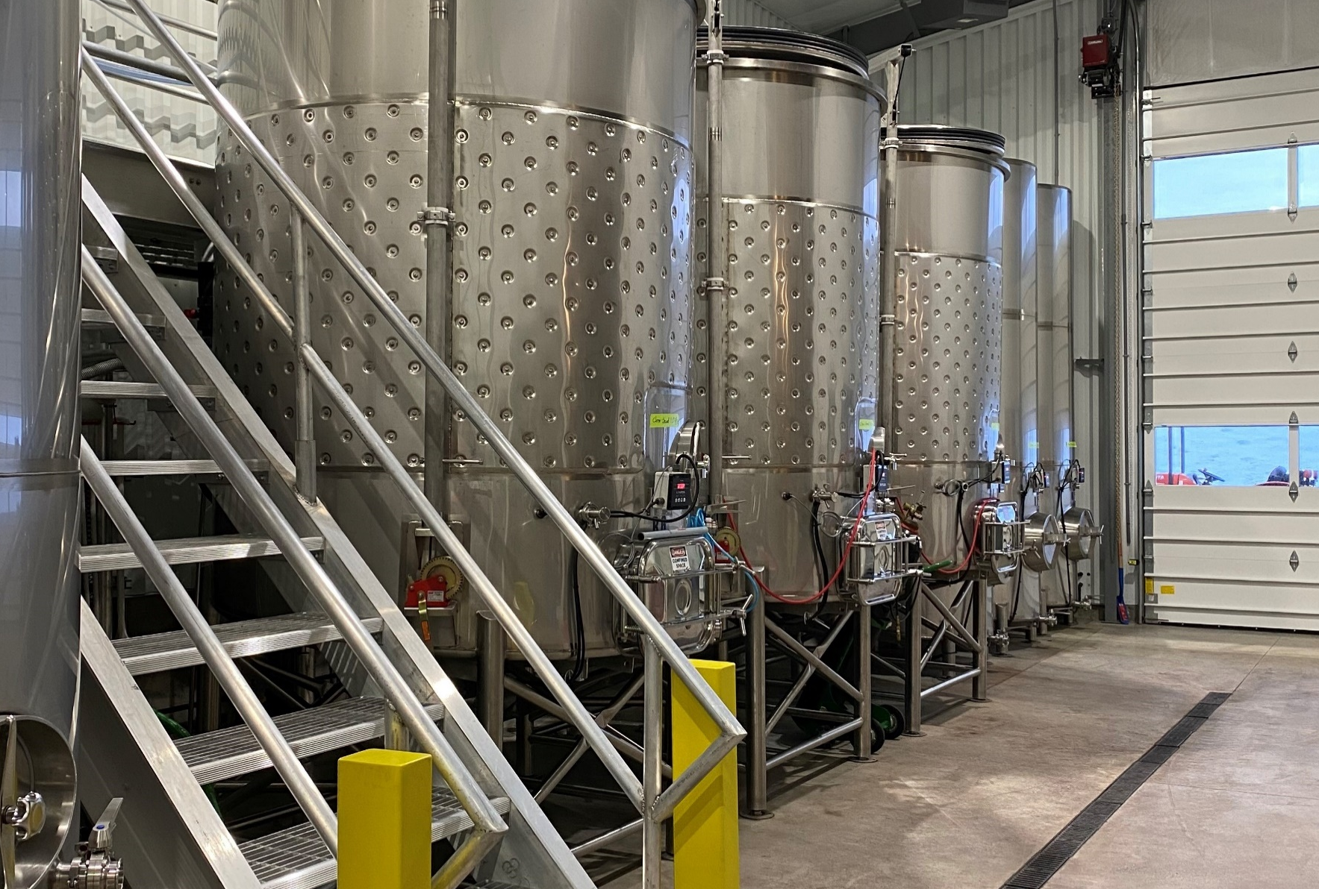
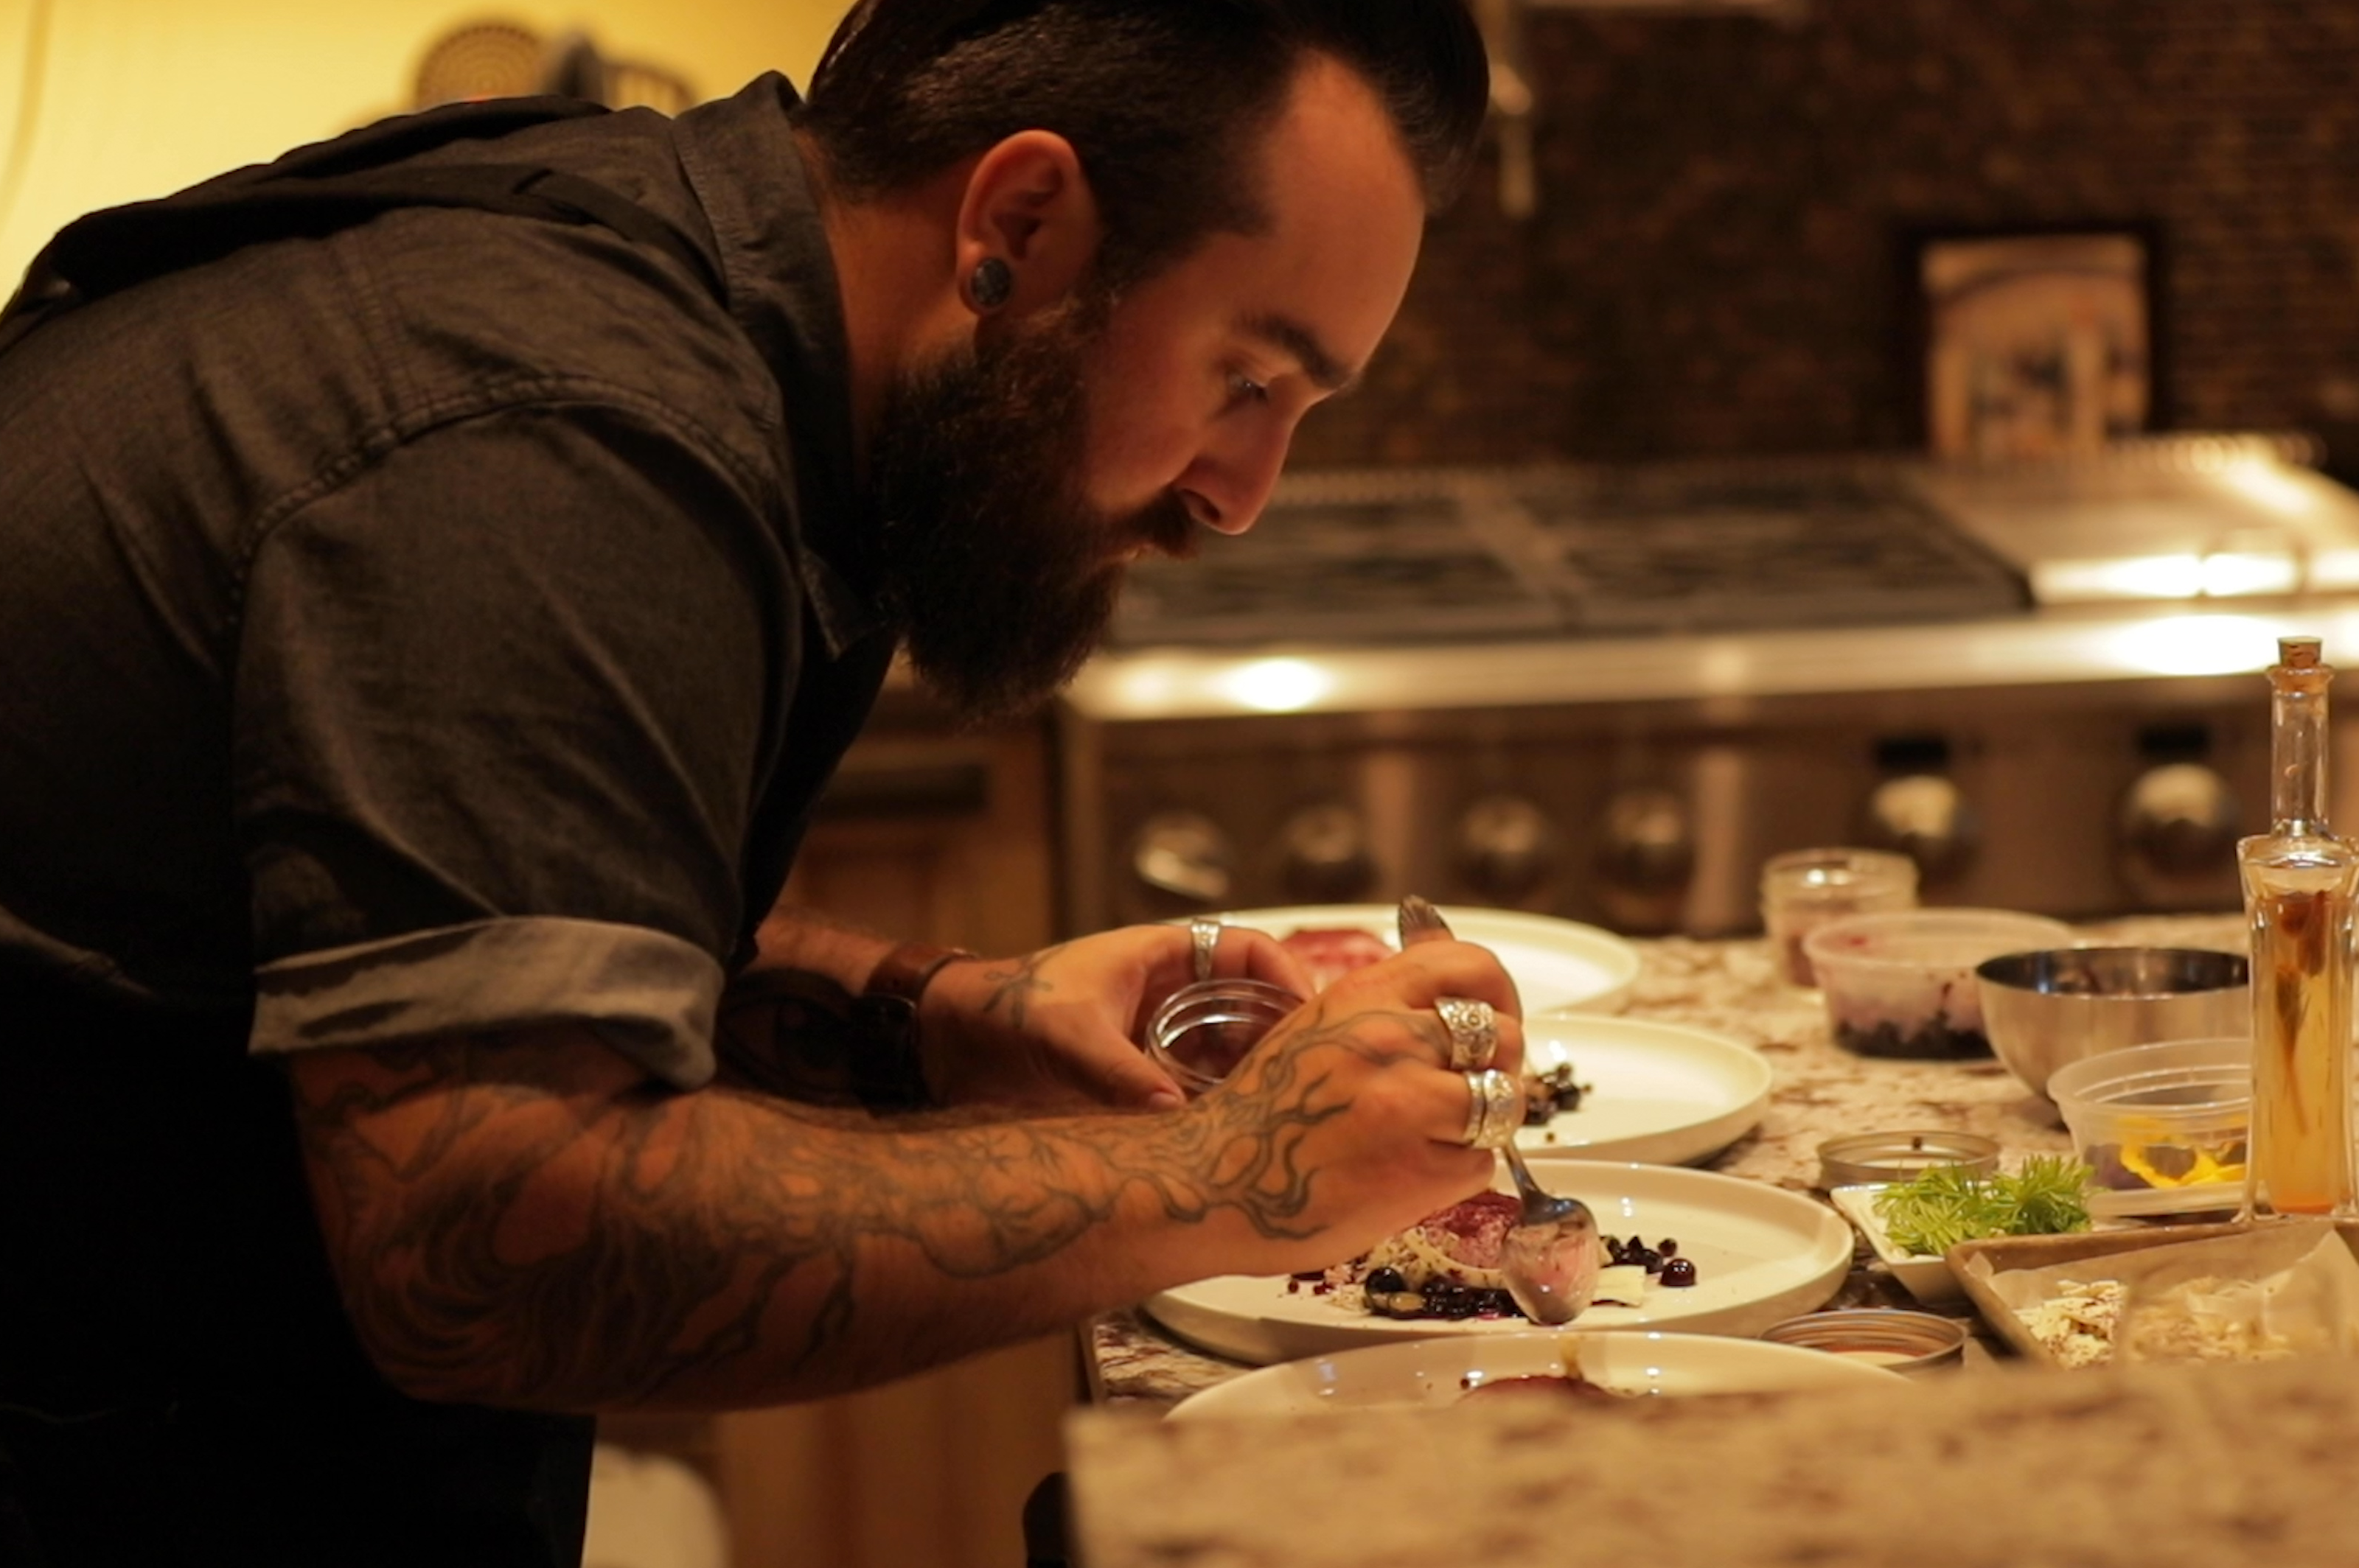
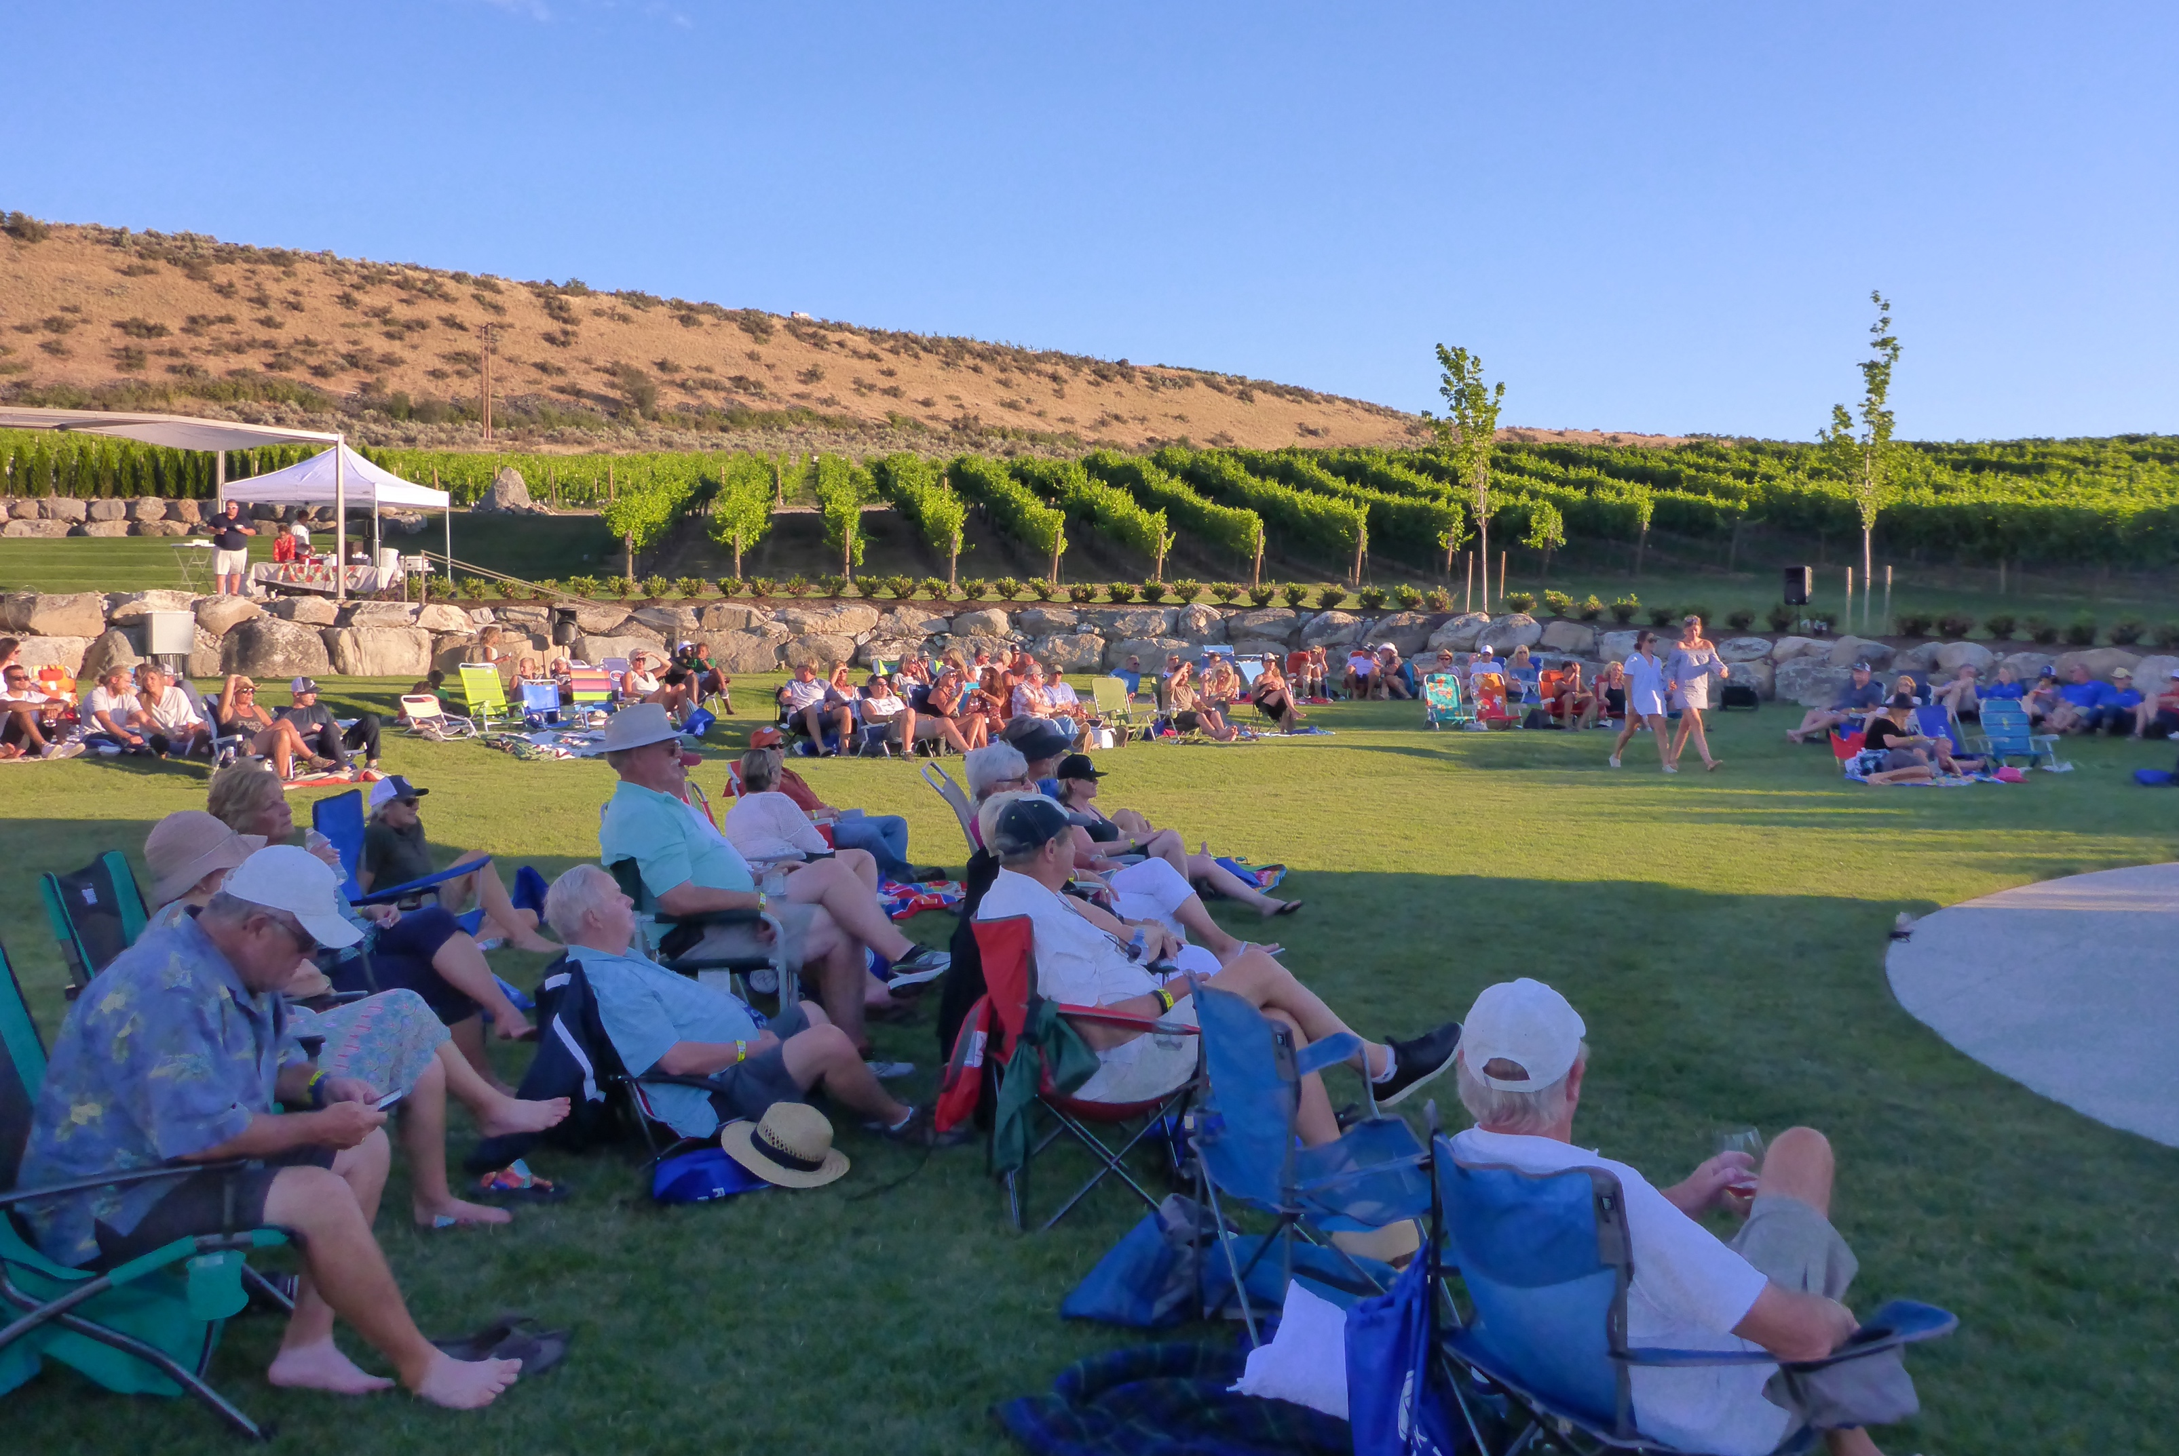
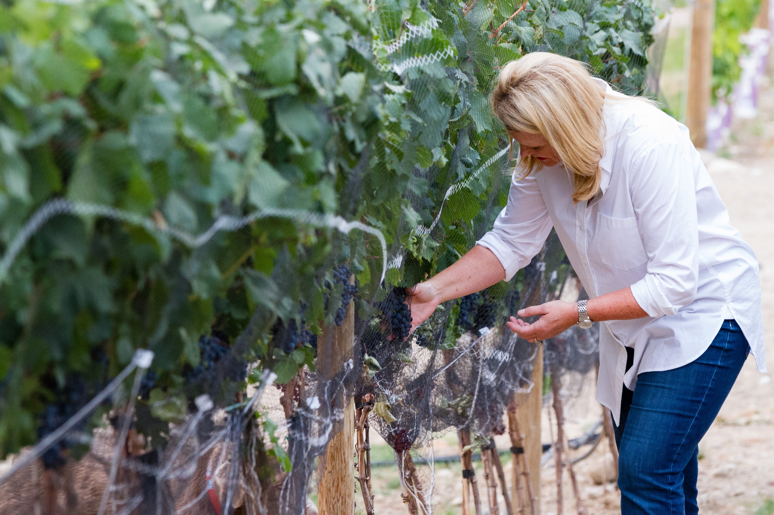
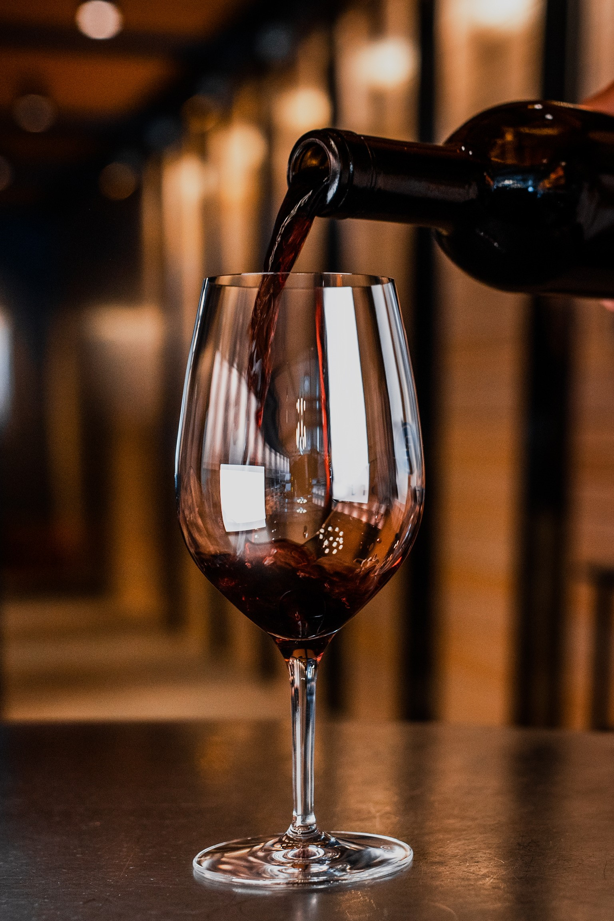
COME VISIT
“It’s all about the experiences…”
-David Dufenhort
Destination Tasting Rooms (Lake Chelan, Woodinville), and The Pond Amphitheatre

Slide 14
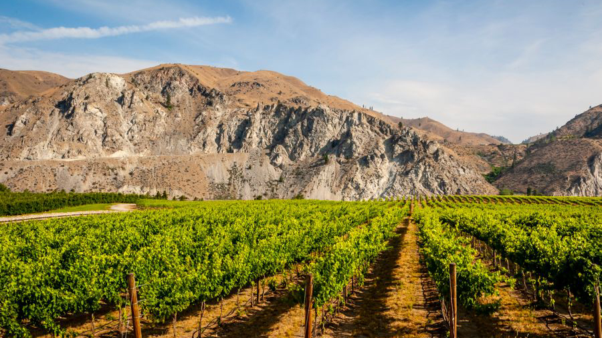
“Just as vines dig roots deep into the soil, they’ve sunk those roots deep into us, too. This is our home.”

